Slide 1
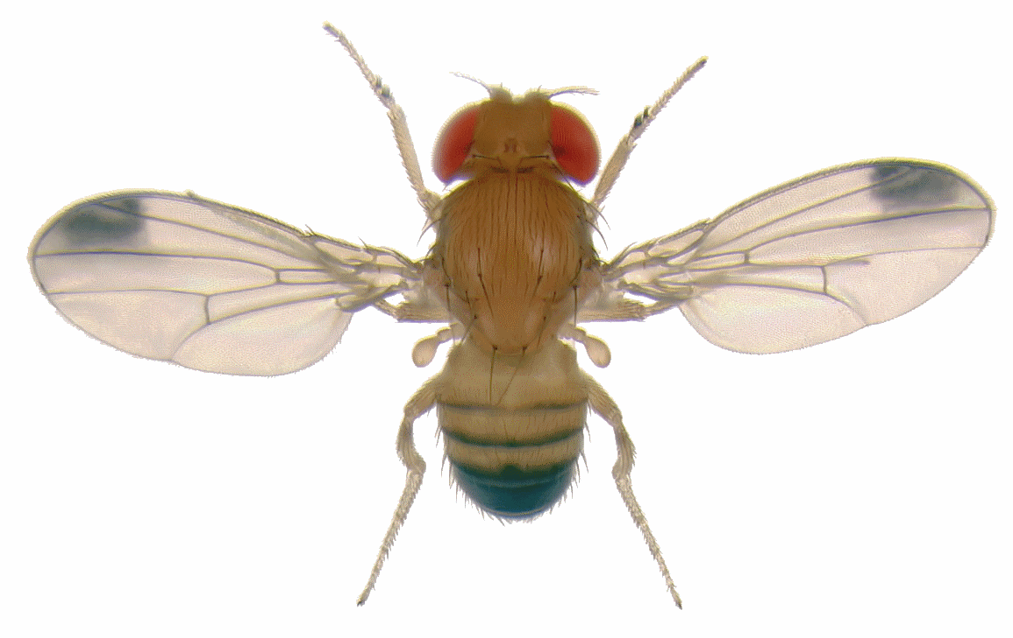
The effect of manipulation of neural circuits by optogenetics on behaviour
RLC
http://www.pixbam.com/fruit-flies
Notes:
Optogenetics = use light to control neurons which have been genetically sensitized to light

Slide 2
Aim of the lab
Cole
To show how specific neural circuit manipulation changes behavior
Introduce optogenetics

Slide 3
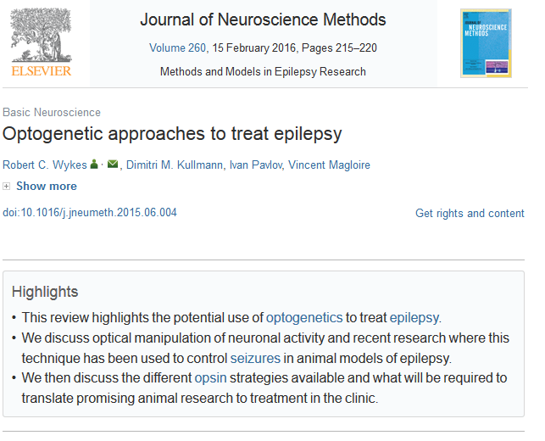
Learning objectives
Cole
New knowledge about neurons and the brain
How different neurotransmitters effect behavior
Integration of lab bench science with the real applications (Translational science)
http://www.sciencedirect.com/science/article/pii/S0165027015002216

Slide 4
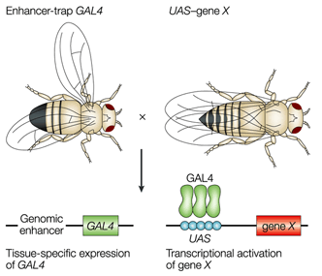
GAL4-UAS system in Drosophila
Cole
GAL4 = transcriptional regulator/ enhancer
(yeast)
UAS = upstream activating sequence/
transcriptional activator of GAL4
regulated genes
Channelrhodopsin2 (ChR2) expression – how does it work?
GAL4 binds to UAS next to the gene of interest (ChR2) and activates the transcription of the ChR2
(Specific enhancer for specific set of neurons)
gene X = ChR2
The art and design of genetic screens: Drosophila melanogaster
Daniel St Johnston
Nature Reviews Genetics 3, 176-188 (March 2002)

Slide 5
Enhancer
Cole
OK371 motor neurons
D42 motor neurons
Gad1 GABAergic neurons
ppk cholinergic/type IV sensory neurons

Slide 6
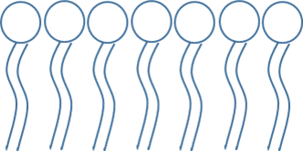
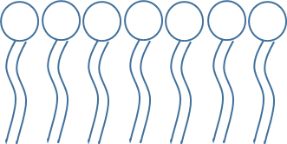

Cole
Mechanism of Channelrhodopsin2 in motor neurons
Channelrhodopsin2 inactivated (normal light)
Na⁺
Ca²⁺
ChR2
NO Muscle contraction

Slide 7
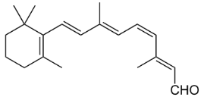


Cole
Mechanism of Channelrhodopsin2 in motor neurons
Channelrhodopsin2 activated (blue light)
Blue light
Na⁺
Ca²⁺
ChR2
Glutamate
Glutamate instead
of Acetylcholine
in Drosophila
Muscle contraction

Slide 8
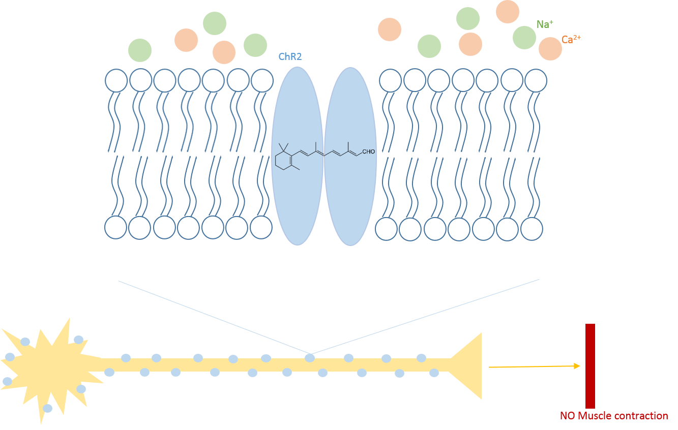
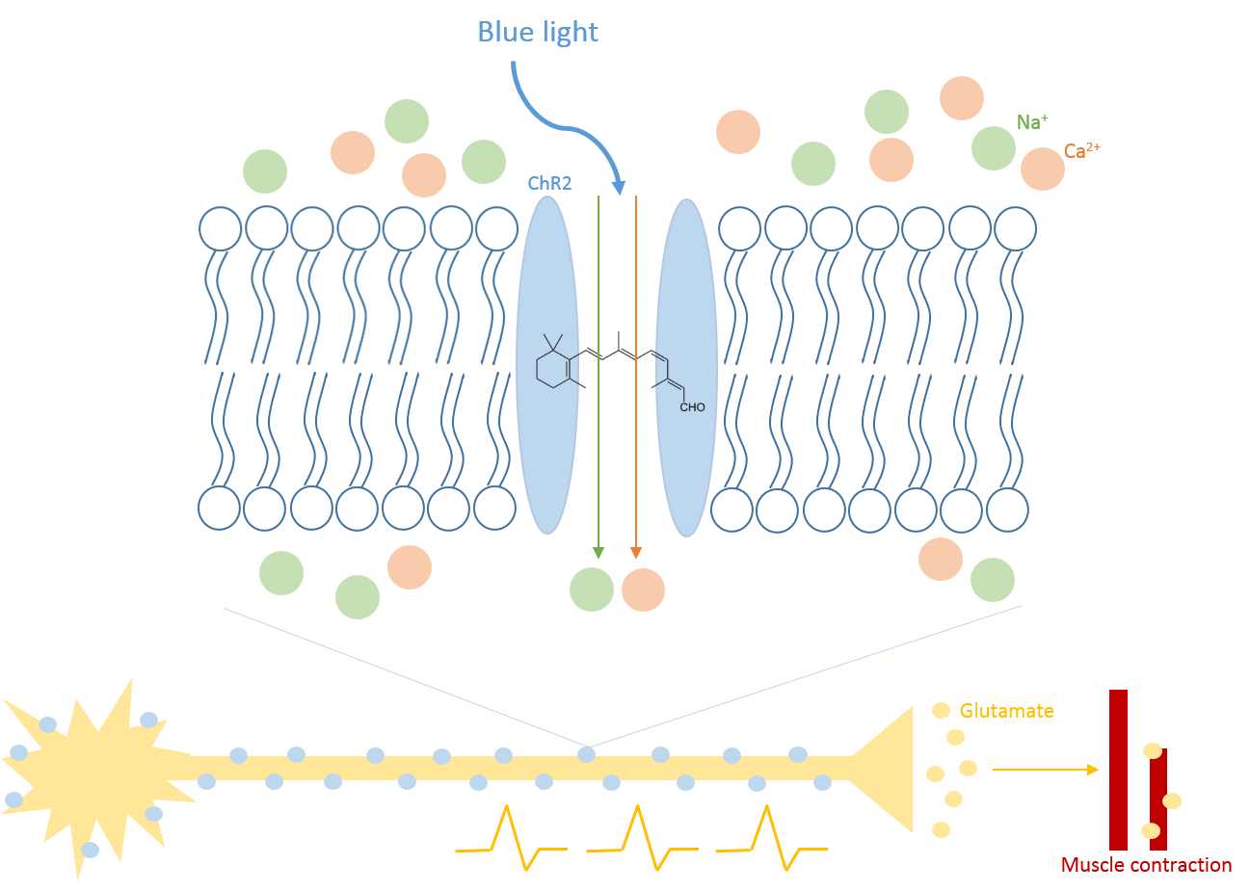
Mechanism of Channelrhodopsin2 in motor neurons
Cole
Channelrhodopsin2 (ChR2) is expressed in motor neurons
ATR inside this protein (from fly food)
Blue light on ChR2: Activation of cation channels (Na⁺, Ca²⁺)
Action potentials in the neuron and Glutamate-release at the neuro-muscular junctions
Muscle contraction visible

Slide 9
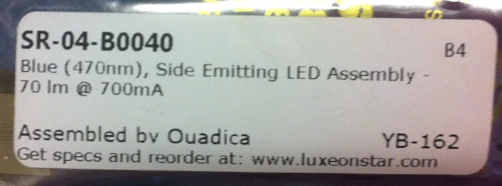
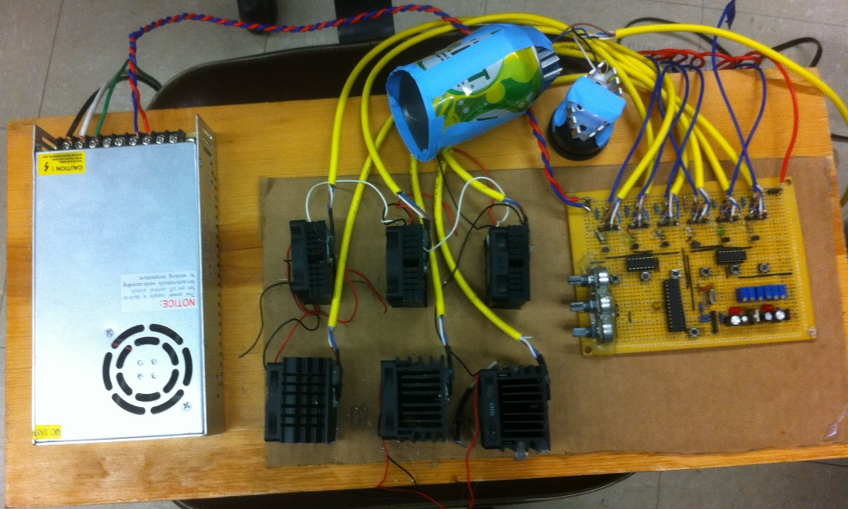
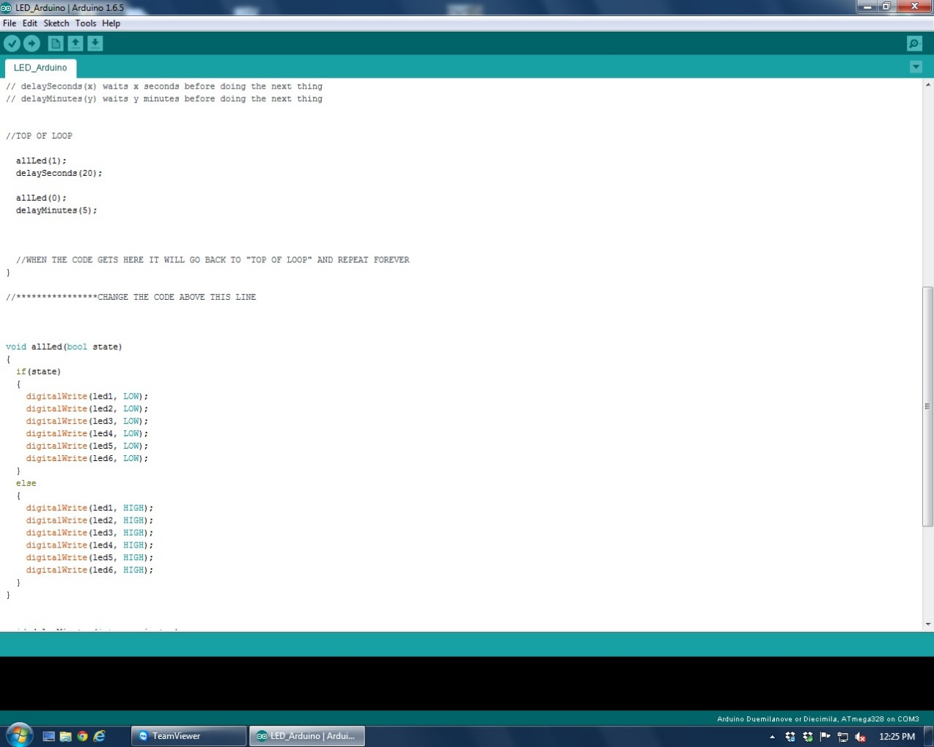
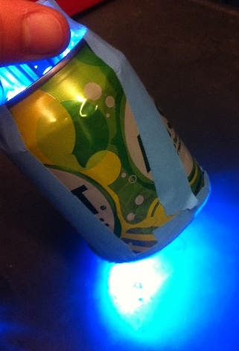
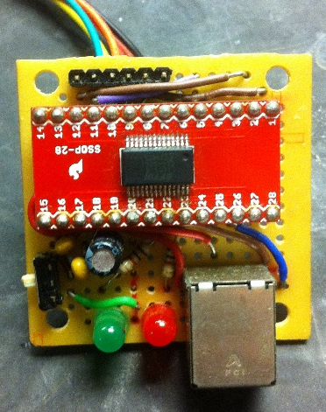
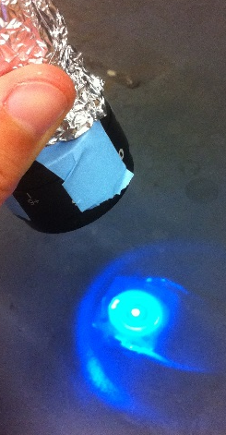
Used blue lights (λ=470nm)
Cole
Soda-can
Focused light
Chip to change the timing
Arduino-Software to change the timing of the blue light

Slide 10
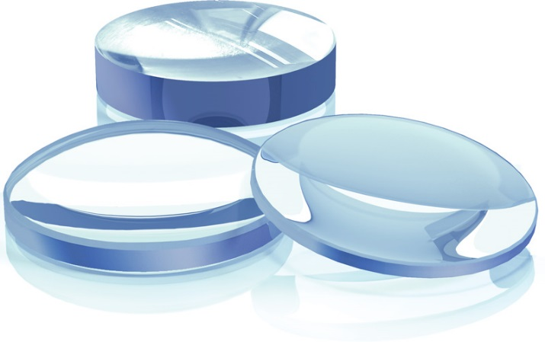
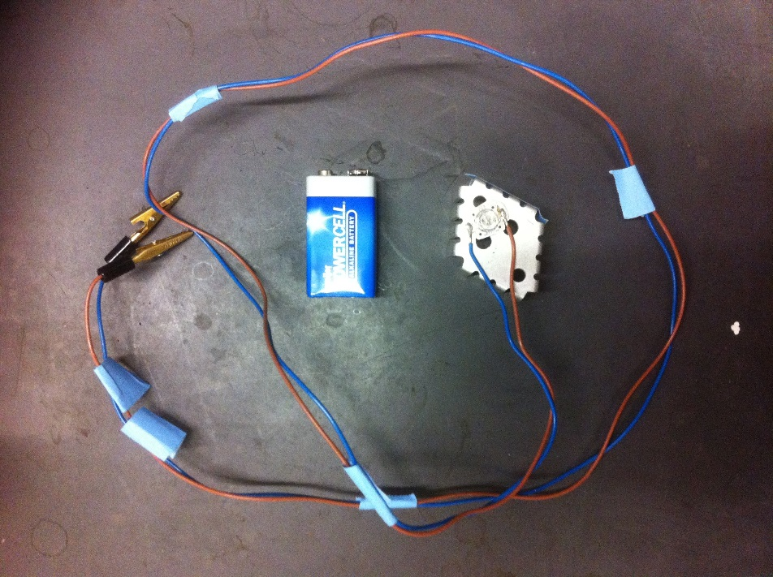
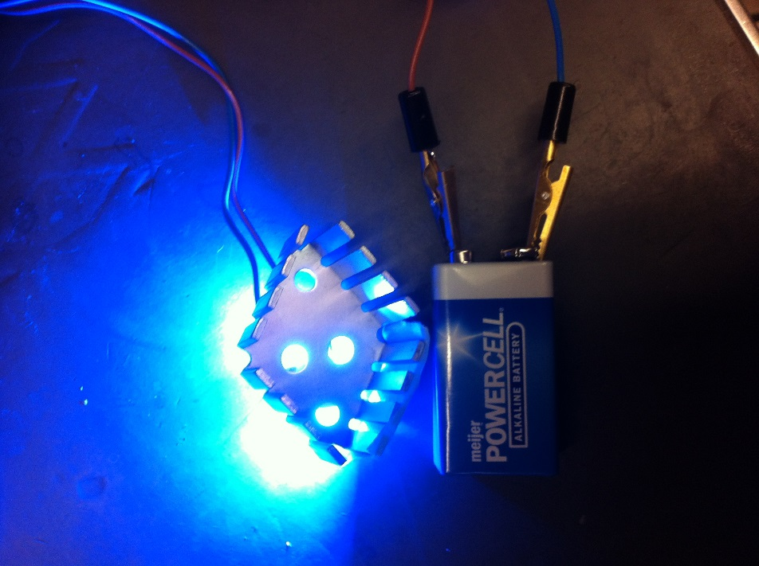
Easier version for teachers and students
Cole
http://www.altechna.de/product_details.php?id=54

Slide 11
γ-aminobutyric acid(GABA)
Dlovan
-Inhibitory neurotransmitter.
-Function :Reduces neuronal excitability throughout nervous system.
-Approximately 17% of the synapses in the mammalian cerebral cortex are GABAergic.
-GABAergic neurons: Neurons that synthesize and release GABA.

Slide 12
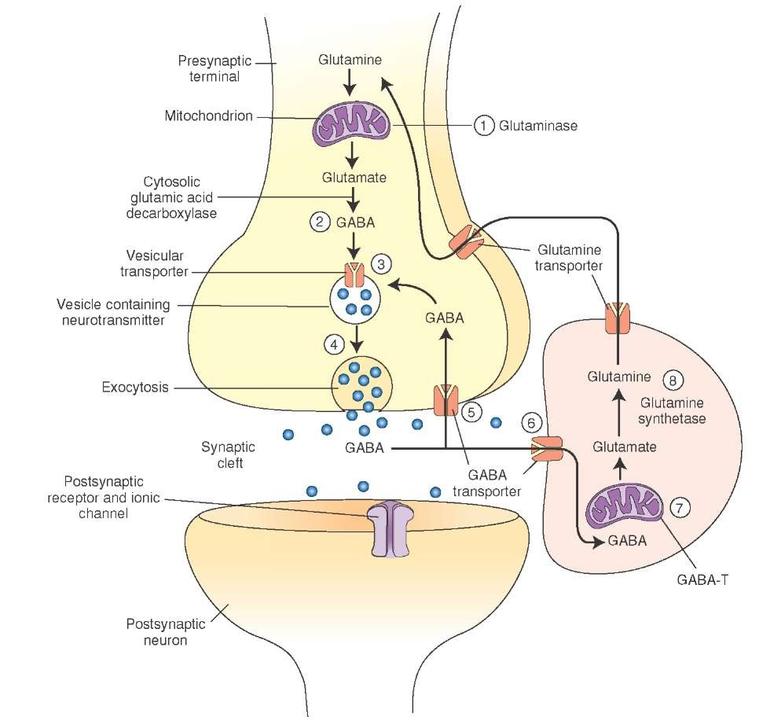
GABA SYNTHESIS
Mammalian system
Dlovan

Slide 13
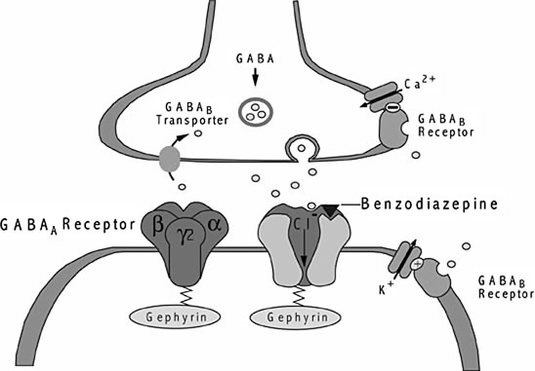
GABAergic synapses.
Dlovan
Encyclopedia of molecular Pharmacology

Slide 14
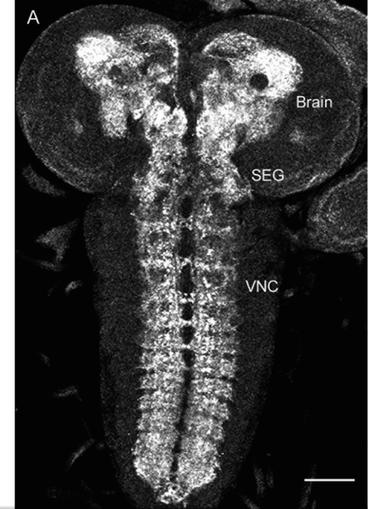
Location of GABA B R in a 3rd instar larval brain
G
Dlovan

Slide 15
58374 UAS-ChR2-XXL x
51630 Gad1-GAL4
Nadera
Notes:
non curly

Slide 16
Bodywall contractions of third instars before and after contact with normal/blue light
UAS-ChR2-XXL x Gad1-GAL4
Nadera

Slide 17
Recovering time of third instars after contact with normal light (microscope)
UAS-ChR2-XXL x Gad1-GAL4

Slide 18
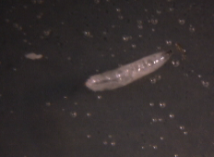

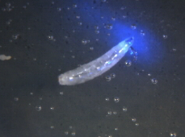
Third instars (minus ATR) in contact with focused blue light
UAS-ChR2-XXL x Gad1-GAL4
Nadera
UAS-ChR2-XXL x Gad1-GAL4 -ATR without EtOH
3rd instar, normal light
UAS-ChR2-XXL x Gad1-GAL4 -ATR without EtOH
3rd instar, focused light

Slide 19
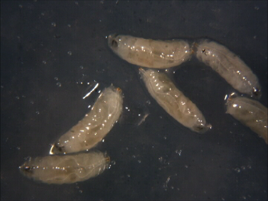
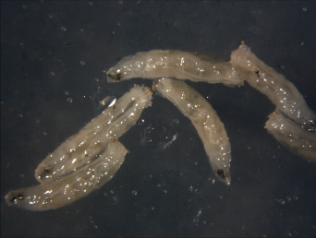
Third instars (plus ATR) in contact with normal light
UAS-ChR2-XXL x Gad1-GAL4
Nadera
UAS-ChR2-XXL x Gad1-GAL4
plus ATR 3rd instars, 10s normal light
UAS-ChR2-XXL x Gad1-GAL4
plus ATR 3rd instars, 5 min normal light

Slide 20
OK371-ChR2
JAY

Slide 21
Overview
OK371-ChR2
Adults in ATR for 4 days (plus ATR)
Adults in 100 % ethanol for 4 days (minus ATR)
Composition of food
  plus ATR: 100 microliters of 100% ethanol + ATR 1mM
  minus ATR: 100 microliters of 100% ethanol
Transfer for egg-laying
  18h post egg-laying: embryos
  22h post egg-laying: first instars

Slide 22
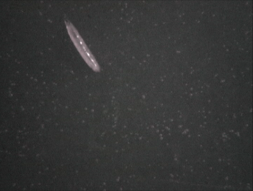
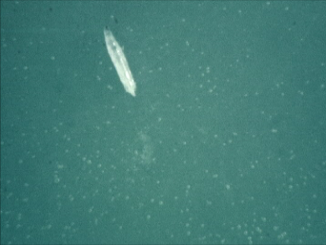
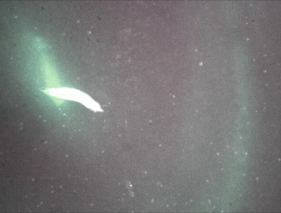
Third instar minus ATR
OK371-ChR2
JAY
OK371-ChR2 -ATR third instar, normal light
OK371-ChR2 -ATR third instar, soda-can
OK371-ChR2 -ATR third instar, focused light

Slide 23
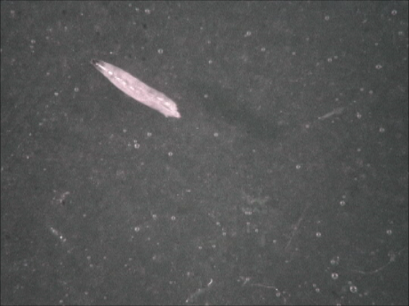

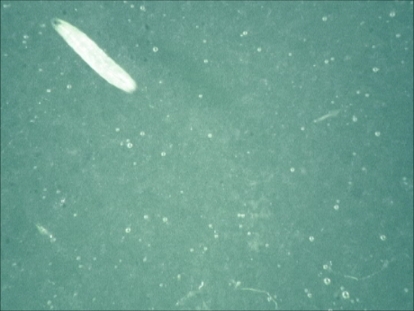
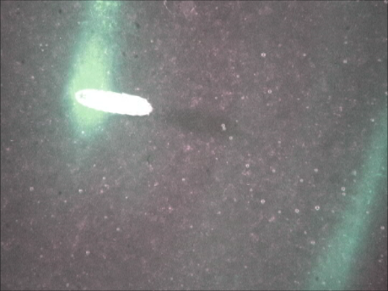
Third instar plus ATR
OK371-ChR2
JAY
OK371-ChR2 +ATR third instar, normal light
OK371-ChR2 +ATR third instar, soda-can
OK371-ChR2 +ATR third instar, focused light

Slide 24
Bodywall contractions of third instars before and after contact with blue light
OK371-ChR2
JAY

Slide 25
Bodywall contractions before and after contact with blue light
JAY

Slide 26
Response of third instars to blue light
(soda-can and focused blue light)
OK371-ChR2
JAY

Slide 27
Response of larva to blue light – Comparison
OK371-ChR2
JAY
1st instars
2nd instars
3rd instars

Slide 28
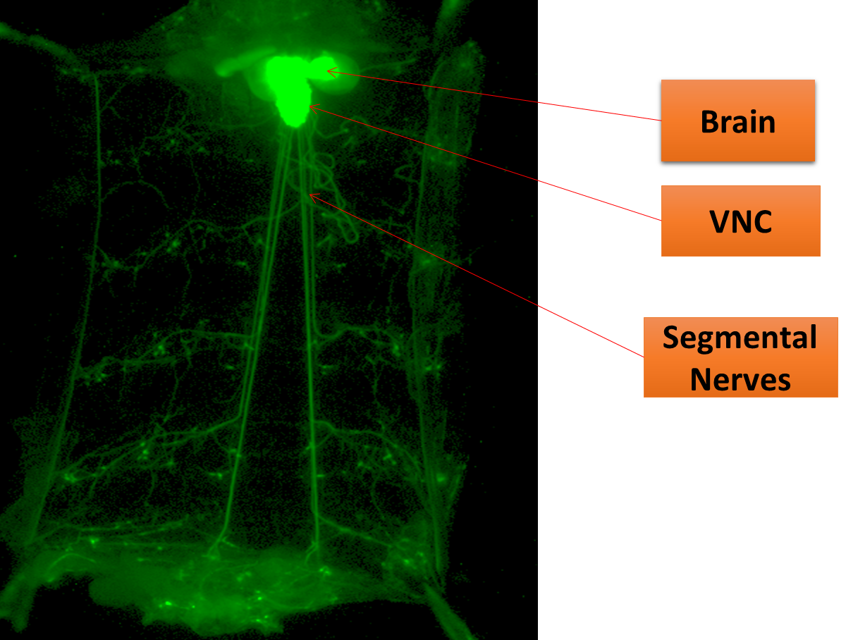
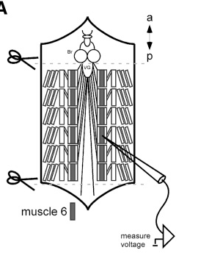
Electrophysiological study
COLE
Steps:
  Pin third instar larvae inside the dissecting dish
  Wash the larvae with HL3-saline
  Add fresh HL3-saline
  Use a pair of iris-scissors to make a medial cut
  Open up the larvae and remove the internal organs (intestine)
  Use a sharp microelectrode to impale the bodywall muscle M6-fiber
  Shine the blue light on to record EPSPs (excitatory postsynaptic potentials)
J Neurophysiol. 2009 Jun;101(6):3075-88. doi: 10.1152/jn.00071.2009. Epub 2009 Apr 1.
Temporal dynamics of neuronal activation by Channelrhodopsin-2 and TRPA1 determine behavioral output in Drosophila larvae.
Pulver SR¹, Pashkovski SL, Hornstein NJ, Garrity PA, Griffith LC.

Slide 29

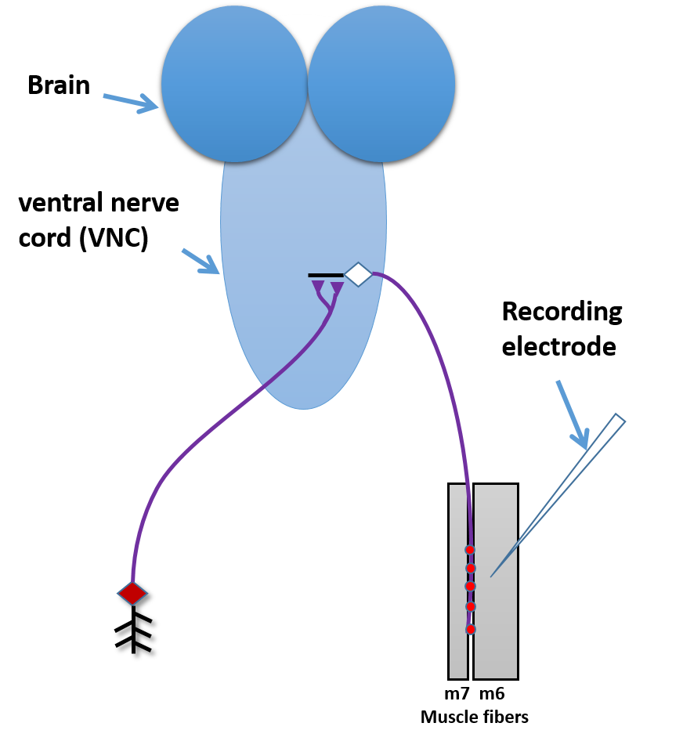
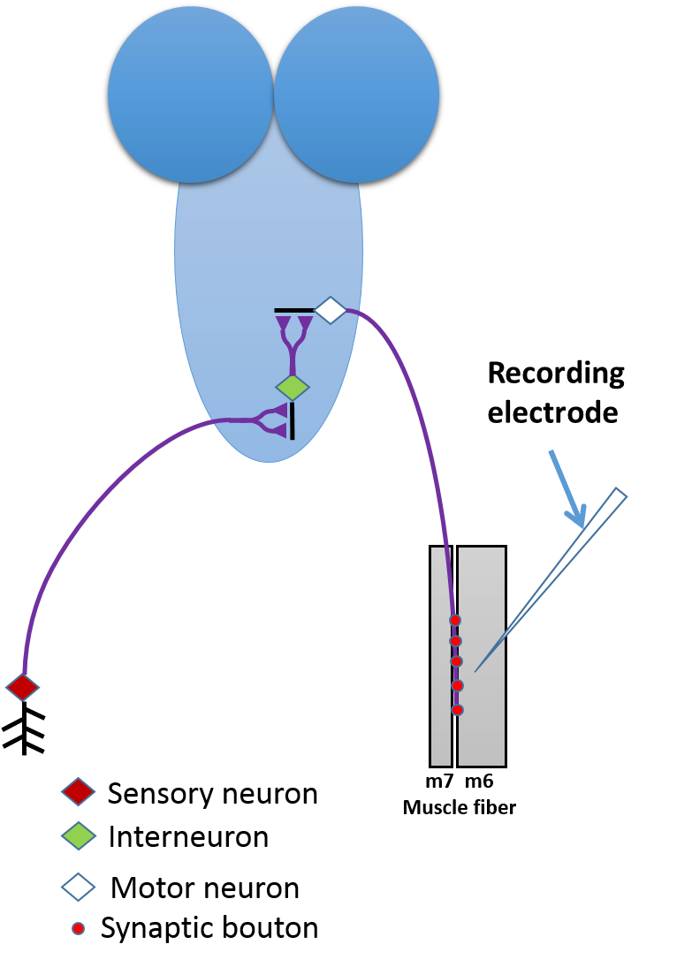
Central nervous system of Drosophila larvae
http://cliparts101.com/free_clipart/65536/Lightbulb_Blue
COLE

Slide 30
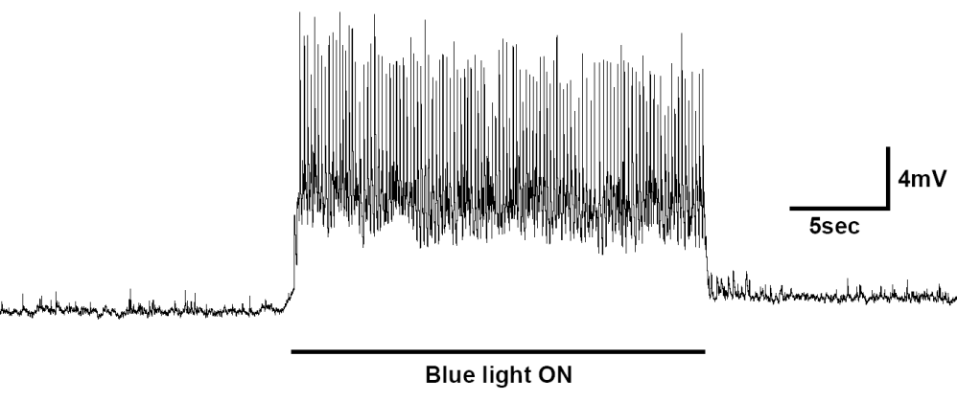
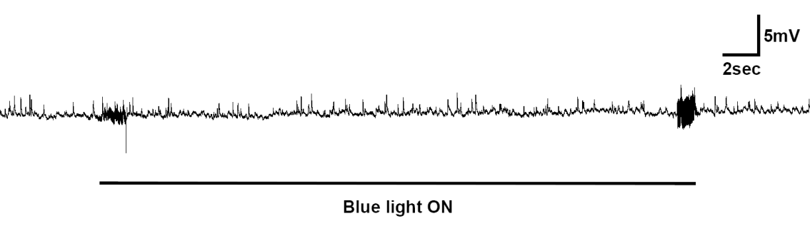
OK371-ChR2 minus ATR (CNS intact)
Soda-can blue light third instar
COLE
OK371-ChR2 plus ATR (CNS intact)
Soda-can blue light
third instar

Slide 31
Potential significance
Class--- what are some applications for this ?
Henry –talk about what you did with the heart.
To understand basic mechanisms of synaptic transmission
To help to understand how neural circuits function in relation to animal behavior
To understand altered activity in neural circuits during development
This basic science could be applied to human health/veterinarian use (stimulate specific neurons)

